Slide 1
Plotly in python
Rafael Robles Echevarria
Advanced Programming OIM 7502
Midterm Project

Slide 2
index
What is Plotly?
Why use Plotly?
Basic Plotly Syntax.
Interactive Visualizations.
Advanced Plotly Features.
Plotly Examples
Quick Start Tutorial
Examples

Slide 3
What is plotly?
Plotly was founded in 2013, it is an open-source interactive plotting library that supports over 40 unique chart types.
Versatile and Dynamic: From basic charts to intricate dashboards.
Supports multiple languages= Python, R, JavaScript, ensuring flexibility.
Interactivity at its core= Easily create plots with zooming, panning, and hover effects for data exploration.

Slide 4
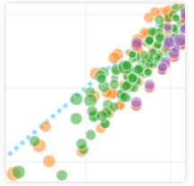
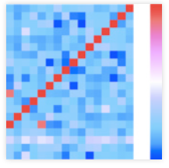
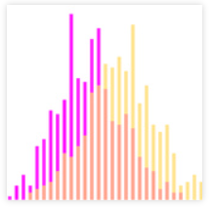
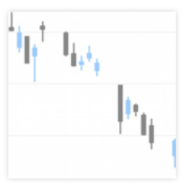
Some possible graphs
ScatterPlots
Heatmaps
Candlestick Charts
Histograms

Slide 5
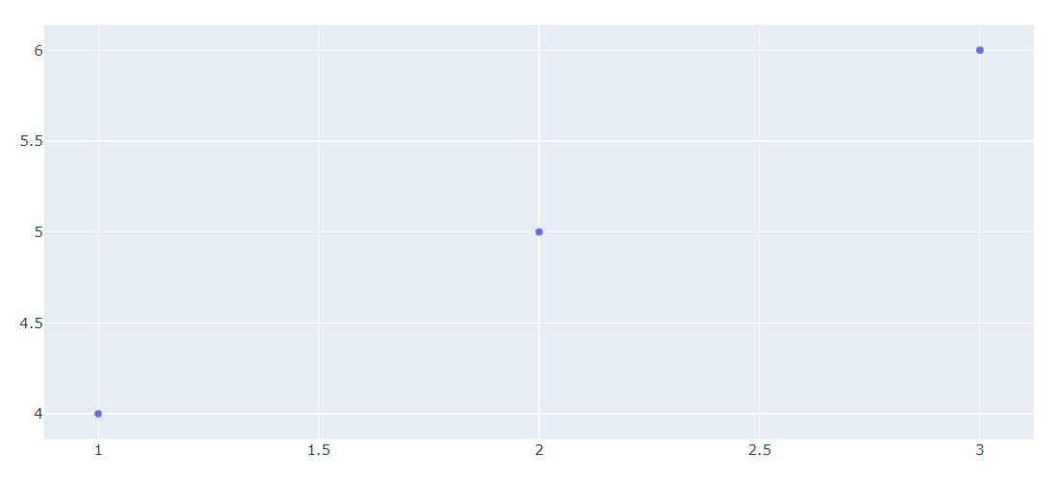
Basic scatter plot

Slide 6
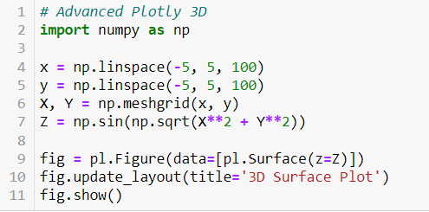
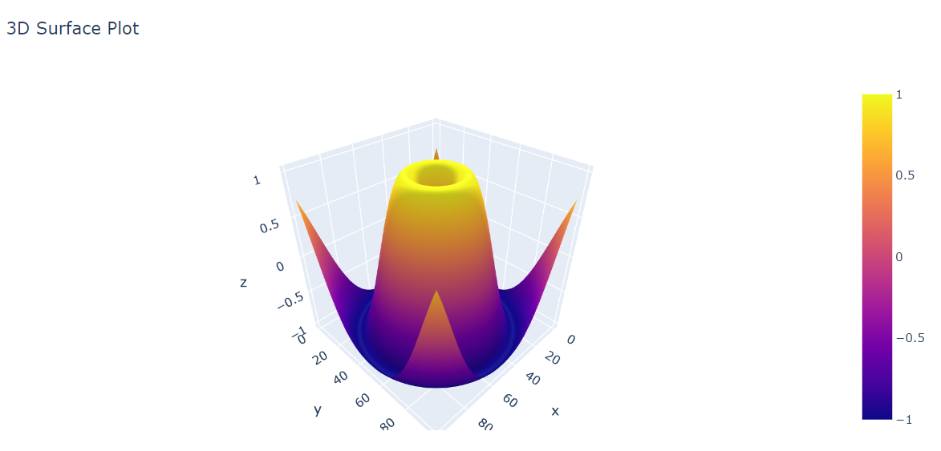
What does advanced plotly look like?

Slide 7
Examples
Correlation Matrix
Stock Price Analysis
Map Data

